Slide 1

Swiftbuy
Adwaid Manoj, Adithya Vinod, Ajay Das, Anamika S
Notes:
1

Slide 2
ABSTRACT
SwiftBuy is an advanced e-commerce solution designed to provide a seamless and personalized shopping experience. With a wide range of product categories like electronics, fashion, and groceries, SwiftBuy allows users to browse and manage products effortlessly. Customers can also read reviews, create wishlists, and receive notifications about exclusive deals and discounts. SwiftBuy offers a secure and intuitive interface, ensuring easy navigation and a user-friendly experience. By integrating tailored recommendations, enhanced usability, and interactive features, SwiftBuy redefines online shopping, providing a convenient and engaging experience for all users.

Slide 3
Research Paper Analysis: E-Commerce Advancements
Online Product Decision Support Using Sentiment Analysis and Fuzzy Cloud-based Multi-Criteria Model
Static ML-Based Usability & Security Analysis in E-Commerce
Sentiment Analysis in E-Commerce Platforms: Review of Techniques & Future Directions
Hybrid Recommendation Systems in E-Commerce: A Systematic Review
Impact of Computer Applications on Cross-Border E-Commerce Performance
OntoCommerce: Ontology & Sequential Pattern Mining for E-Commerce Recommendations
End-Cloud AI Framework for E-Commerce Customer Service
E-Commerce Image Enhancement via Instance Segmentation & Background Replacement

Slide 4
Online Product Decision Support Using Sentiment Analysis and Fuzzy Cloud-based Multi-Criteria Model - Yang Z., Li Q., Vincent C., Xu B., Gupta S.
Methodology
BiLSTM-CRF, sentiment analysis, and K-means for product attribute mining
q-Rung Orthopair Fuzzy Cloud (q-ROFC) for sentiment error analysis
Multi-platform decision framework using fuzzy set theory
Future Scope
Expansion to other domains
Real-time consumer behavior analysis

Slide 5
ADVANTAGES
Enhanced accuracy in mining product sentiments.
Combines cross-platform reviews for better decision-making.
DISADVANTAGES
Limited focus on real-time scalability.
Possible bias from uneven review distribution and fake reviews.

Slide 6
2. Static ML-Based Usability & Security Analysis in E-Commerce -Kumar B., Roy S., Singh K.U., Pandey S.K., Kumar A., et al.
Methodology
AHP, VIKOR, TOPSIS for decision-making
User surveys for usability assessments
Security checks via online malware scanners
Future Scope
Real-time adaptive evaluation
Global e-commerce platform expansion

Slide 7
ADVANTAGES
Combines usability and security metrics effectively
Provides insights into e-commerce website performance in rural regions.
DISADVANTAGES
Limited sample size and geographic focus..
Does not address dynamic usability trends.

Slide 8
3. Sentiment Analysis in E-Commerce Platforms: Review of Techniques & Future Directions
- Huang H., Asemi Zavareh A., Mustafa M.B.
Methodology
Reviewed 54 studies on sentiment analysis in e-commerce
Explored ML (SVM, Naive Bayes) & DL (RNN, LSTM, BERT) techniques
Categorized data sources (Amazon, Twitter, IMDB) & research gaps
Future Scope
Universal models for multi-language & cross-domain analysis
Enhanced implicit aspect recognition & sarcasm detection

Slide 9
ADVANTAGES
Combrehensive comparison of machine learning and deep learning techniques
Identified future research directions
DISADVANTAGES
Limited focus on non-English language datasets
Lacks experimental validation of proposed research directions.

Slide 10
4. Hybrid Recommendation Systems in E-Commerce: A Systematic Review
-Bodduluri K.C., Palma F., Kurti A., Jusufi I., Löwenadler H.
Methodology
Reviewed 48 studies on hybrid recommendation systems
Used data synthesis, quality assessment, and trend analysis
Future Scope
AI integration, explainable models, multimodal data fusion, standardized metrics

Slide 11
ADVANTAGES
Improves recommendation accuracy, scalability, robustness, and personalization.
DISADVANTAGES
Persistent issues include cold start problems, data sparsity, and complexity in evolving user behavior.

Slide 12
5. Impact of Computer Applications on Cross-Border E-Commerce Performance
-Jin L., Chen L.
Methodology
Genetic Algorithm & CNNs for performance optimization
Focused on efficiency, predictive accuracy, and customer satisfaction
Future Scope
Blockchain for secure transactions, AI for personalization, ethical AI for privacy & security

Slide 13
ADVANTAGES
Enhances operational efficiency, predictive accuracy, and customer satisfaction by leveraging data analytics and machine learning models.
DISADVANTAGES
Challenges include computational complexity ,sensitivity to parameter settings ,and regulatory compliance issues

Slide 14
6. OntoCommerce: Ontology & Sequential Pattern Mining for E-Commerce Recommendations
-Mustafa G. et al.
Methodology
Hybrid recommender system using ontology for domain knowledge & Sequential Pattern Mining (SPM) for purchase patterns
Future Scope
Extend to other domains & improve scalability

Slide 15
ADVANTAGES
Provides highly personalised recommendations
Tackles cold-start and data sparsity issues effectively
DISADVANTAGES
Dependency on accurate ontology construction
High computational complexity

Slide 16
7. End-Cloud AI Framework for E-Commerce Customer Service
- Teng L., Liu Y., Liu J., Song L.
Methodology
Integrates cloud-based large models with end-device AI for real-time, privacy-preserving customer support
Future Scope
Expand deployment across industries with better optimization

Slide 17
ADVANTAGES
Combines local model efficiency with cloud model intelligence
Ensures privacy and adaptability
DISADVANTAGES
Requires substantial initial setup
High training costs

Slide 18
8. E-Commerce Image Enhancement via Instance Segmentation & Background Replacement
-Gao Q., Hu H., Liu W.
Methodology
Uses Fast-SAM segmentation, background replacement, & shadow generation for product image enhancement
Future Scope
Expand dataset diversity & apply to fields like medical imaging & artwork analysis

Slide 19
ADVANTAGES
Improves product visual appeal and recognition accuracy
Maintains computational efficiency
DISADVANTAGES
Limited generalizability to diverse product datasets.
Computational overhead for real-time applications

Slide 20
System Architecture Requirements
Frontend
ReactJS will be used for the frontend, providing a responsive and interactive user interface
Backend
Node.js with Express will handle the backend logic, including API endpoints and data processing.
Database
MongoDB will serve as the database, providing a flexible and scalable data storage solution.

Slide 21
REQUIREMENTS
HARDWARE REQUIREMENTS | SOFTWARE REQUIREMENTS
PROCESSOR - Intel i3/i5/i7 processors offer sufficient performance for this application. | WINDOWS - Windows 8 or above is supported.
RAM - 8GB of RAM is recommended, with 16GB providing optimal performance. | LINUX - Linux distributions are supported.
STORAGE - A 256GB HDD is sufficient, but an SSD will significantly improve performance. | MAC - Mac operating systems are compatible.
NETWORK - A high-speed internet connection is essential for smooth operation.

Slide 22
Project Plan
Plan | Given Date | Expected Date | Status
Project Initialization | 19/12/24 | 19/12/24 | completed
Literature Review | 09/01/25 | 09/01/25 | completed
Abstract | 23/01/25 | 23/01/25 | completed
SRS | 30/01/25 | 30/01/25 | completed
Design Document | 06/01/25 | 06/01/25 | completed
Test Plan | 20/02/25 | 20/02/25 | completed
First Plan | 27/02/25 | 27/02/25 | completed
Second Plan | 27/02/25 | 27/02/25 | completed
Project Report | 27/03/25 | 27/03/25 | completed
Final PPT | 03/04/25 | 03/04/25 | completed

Slide 23
Test Case
Test Case | Module | Objective | Expected Result
TC01 | Product Browsing | Verify that users can view products across all categories | Product listings load correctly with images and details
TC02 | Filtering | Ensure that category and filter options work as intended | Products are filtered based on selected criteria
TC03 | Wishlist | Check if users can add and manage items in their wishlist | Items are added/removed from wishlist and persist across sessions
TC04 | Customer Reviews | Verify that users can view and submit product reviews | Reviews are displayed and new ones are submitted successfully
TC05 | Search Functionality | Ensure the search bar returns relevant product results | Accurate product results are shown based on keywords
TC06 | Checkout Process | Validate the cash on delivery checkout flow | Order is placed successfully with COD option selected
TC07 | User Interface | Confirm that the UI is clean and intuitive for users | Users can navigate the site easily without confusion
TC08 | Accessibility | Check that the platform is accessible to all users including those with disabilities | All accessibility features function correctly (e.g., keyboard navigation, screen readers)
TC09 | Security | Ensure secure handling of user data and sessions | User data is protected and sessions are securely managed
TC10 | Full Purchase Flow | Test end-to-end shopping from browsing to checkout | User can complete a full purchase with no errors

Slide 24
Test Plan
Test Case ID | Test Description | Input | Expected Output | Actual Result
TC01 | Browse product categories | User selects a category | Product list appears | Products displayed
TC02 | Filter products by criteria | User applies filters (e.g., price, brand) | Filtered products shown | Filter works correctly
TC03 | Add item to wishlist | User clicks 'Add to Wishlist' | Item saved to wishlist | Item added successfully
TC04 | View/submit customer reviews | User visits product page or adds review | Reviews visible or new review saved | Reviews shown/submitted
TC05 | Search for products | User enters keyword in search bar | Relevant products displayed | Correct results shown
TC06 | Checkout using cash on delivery | User places order with COD option | Order confirmation | Order placed with COD
TC07 | Access user interface | User loads SwiftBuy in browser | Homepage loads properly | UI loads and functions
TC08 | Test platform accessibility | Navigation via keyboard/screen reader | Accessible controls and labels | Accessibility confirmed
TC09 | Verify data security | User logs in and browses site | Session secured, data protected | No data/security issues
TC10 | Full purchase workflow | User browses, selects, and orders | End-to-end flow completes | Purchase successful

Slide 25
Traceability matrix
Requirement ID | Requirement Description | Linked Test Case ID(s)
R01 | Product browsing functionality | TC01
R02 | Filtering capability across products | TC02
R03 | Wishlist management features | TC03
R04 | Customer review system | TC04
R05 | Search functionality | TC05
R06 | Checkout process with COD | TC06
R07 | User interface usability | TC07
R08 | Accessibility features | TC08
R09 | Data and session security | TC09
R10 | Complete purchase workflow | TC10

Slide 26
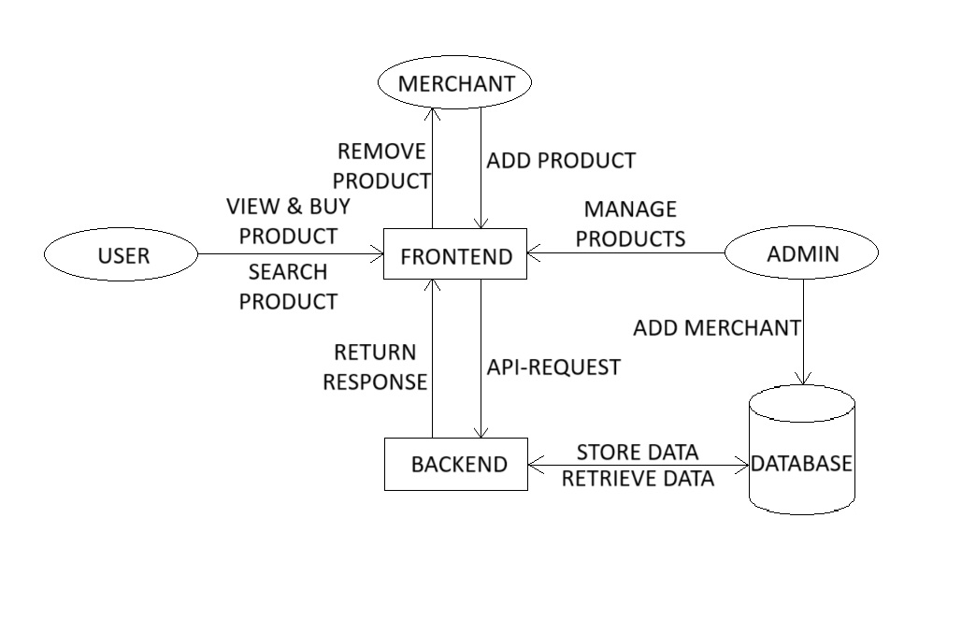
ARCHITECTURE DIAGRAM

Slide 27
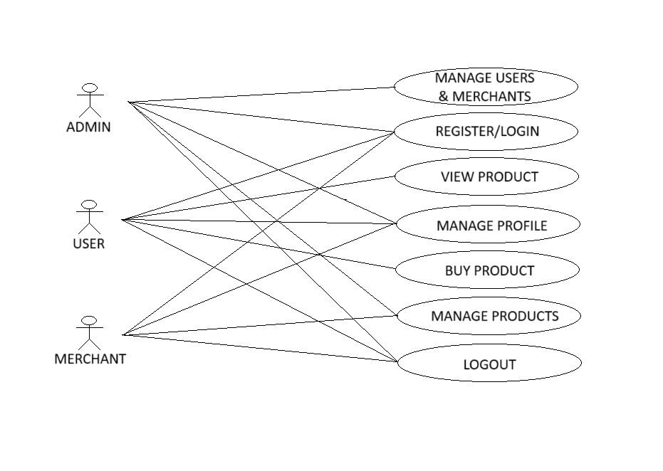
USE CASE DIAGRAM

Slide 28
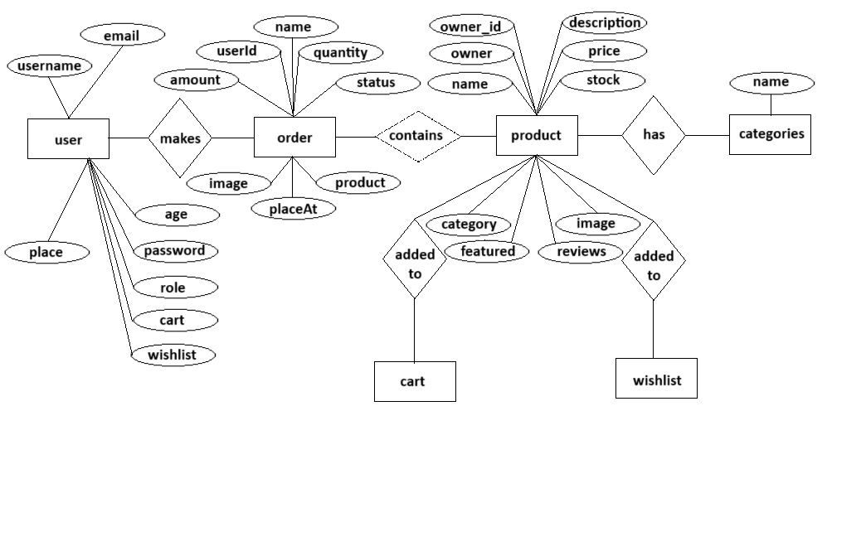
ER DIAGRAM

Slide 29
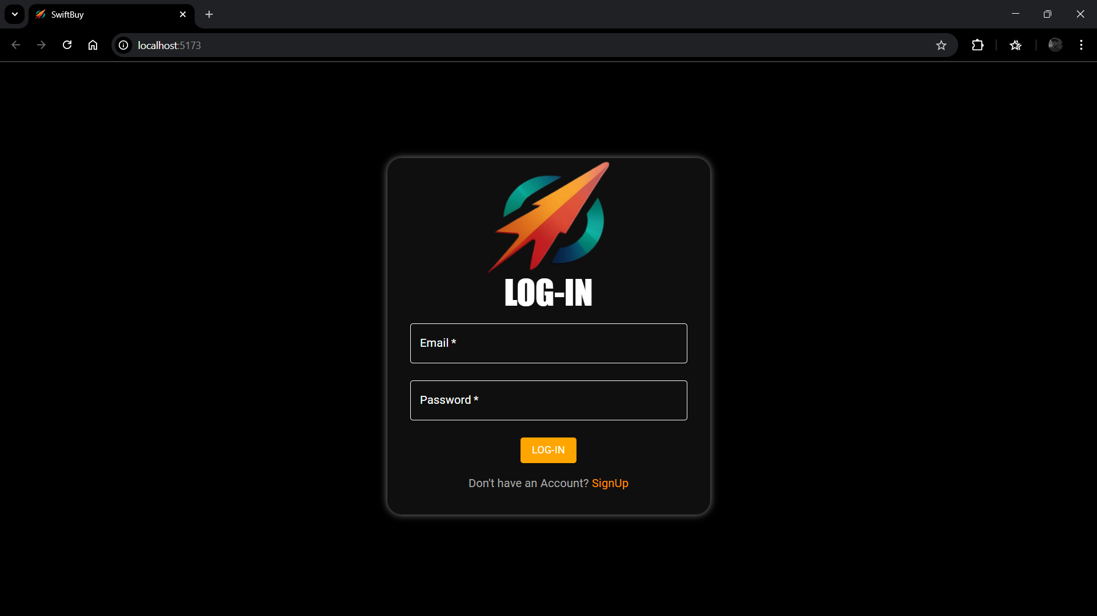
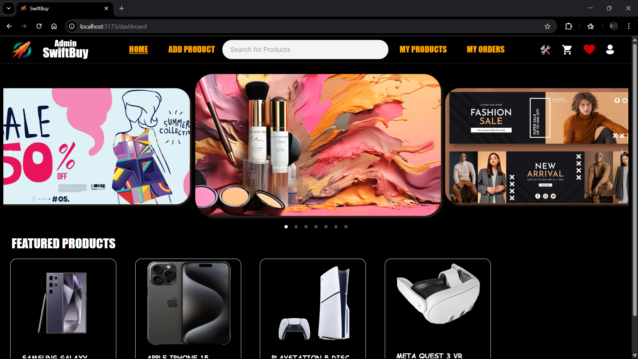
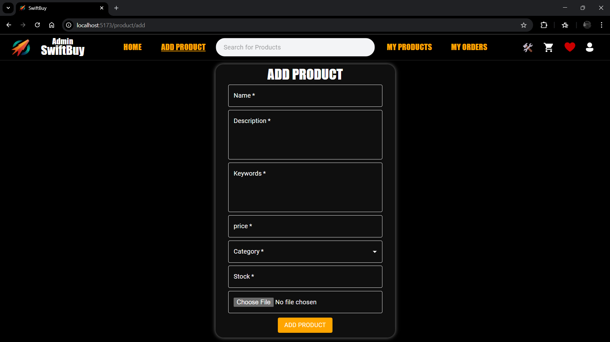
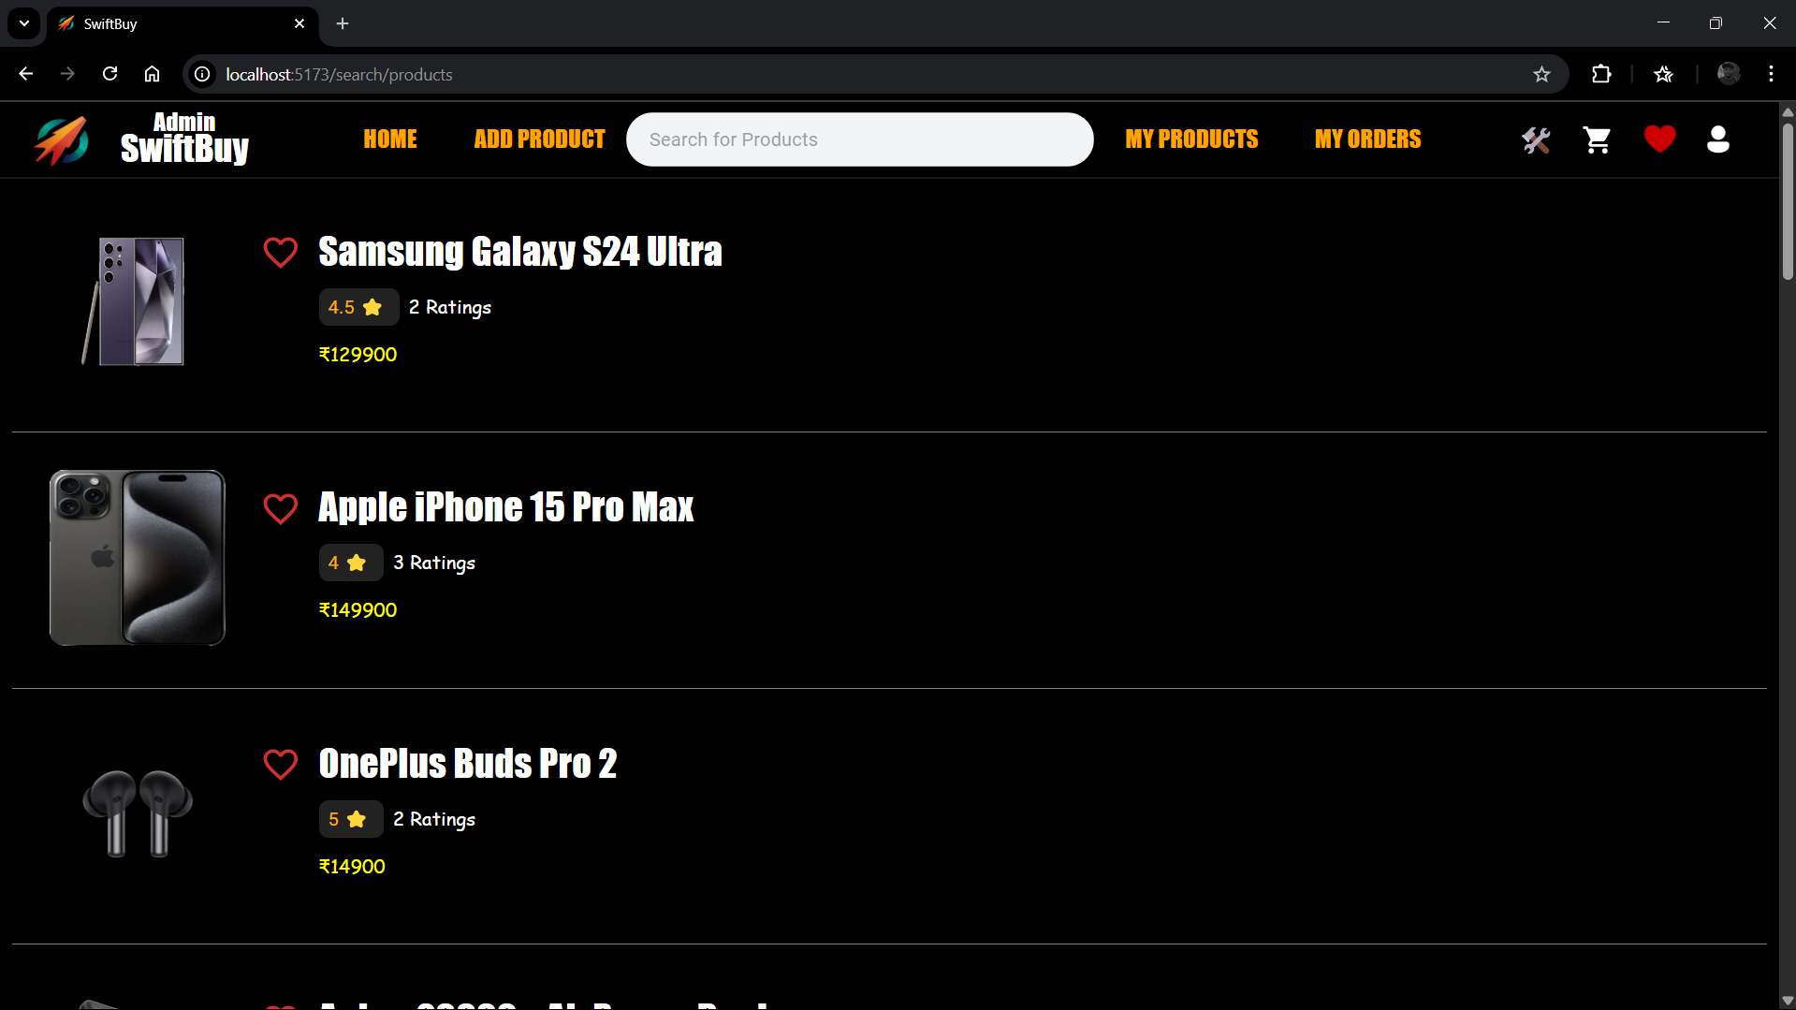
OUTPUT

Slide 30
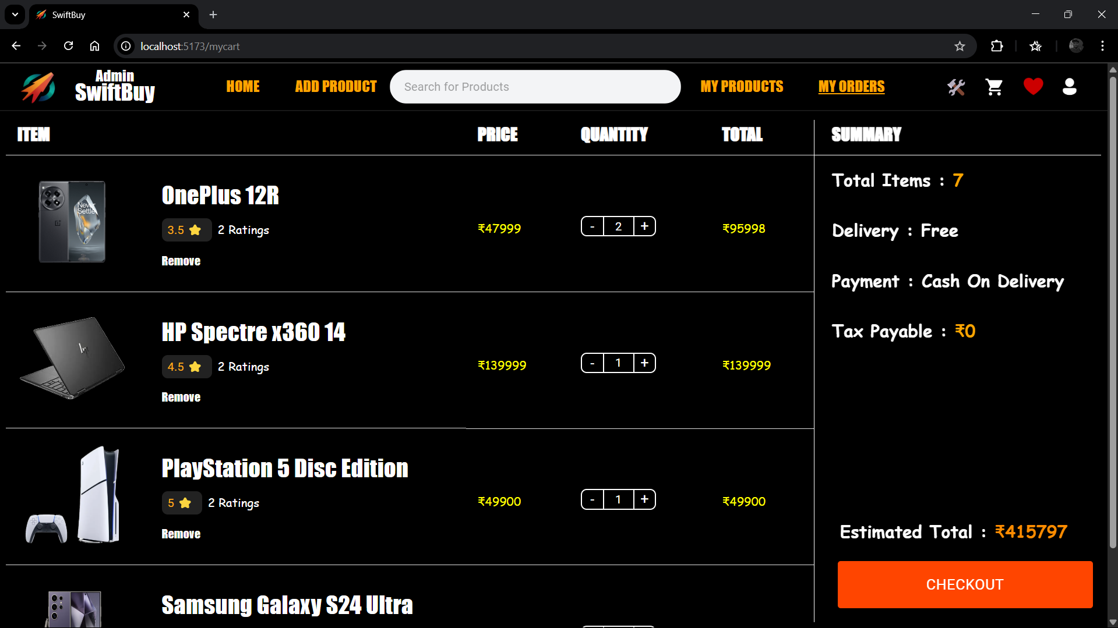
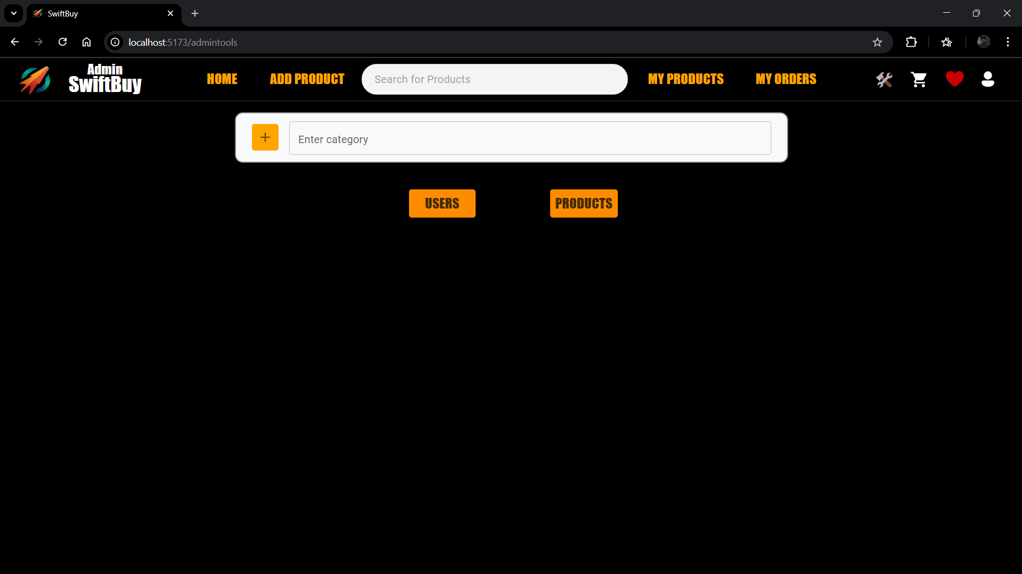
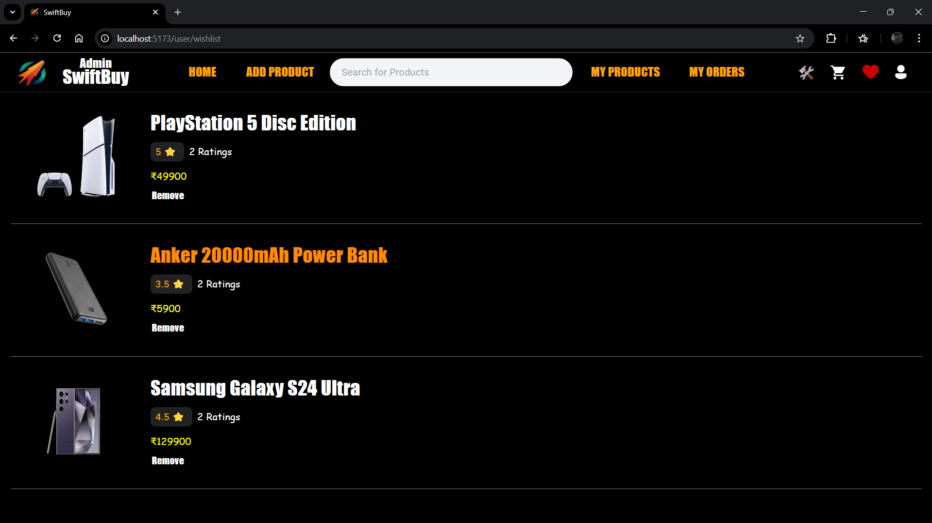
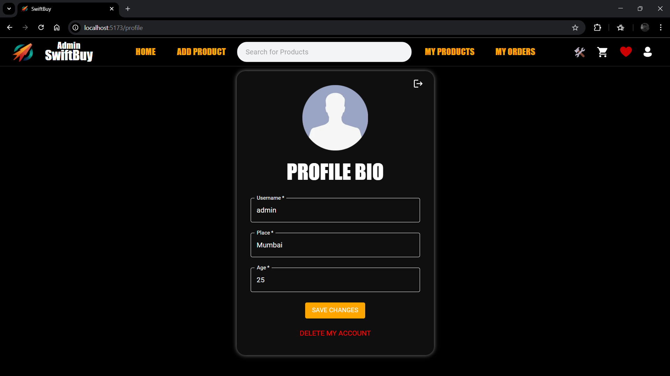

Slide 31
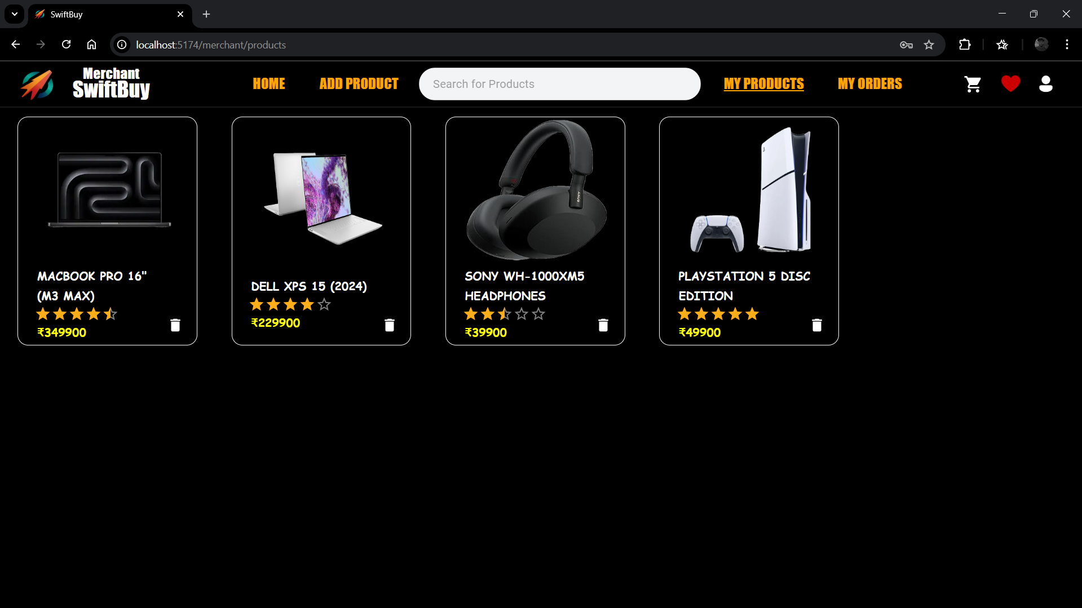
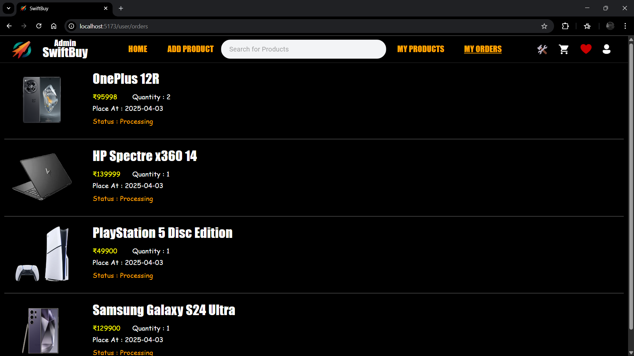

Slide 32
FUTURE SCOPE
AI Driven Recommendations: Integrating machine learning to offer personalized product suggestions based on user preferences, browsing history, and trends.
Simplifying Product Discovery with Essential Filters: Instead of overwhelming users with complex search tools, SwiftBuy offers straightforward filtering options that help shoppers find what they need quickly.
Supporting Seamless and Secure Checkout: With cash on delivery as its primary payment method, the platform ensures a simple, secure, and familiar transaction process for users of all backgrounds.
Enhancing Usability Through Lightweight Design: SwiftBuy is built to perform smoothly on a wide range of devices, offering fast load times and a responsive experience even in low-bandwidth environments.
Making E-commerce More Accessible: With features like wishlists, customer reviews, and intuitive navigation, SwiftBuy lowers the barrier to entry for online shopping, making it easy for anyone—from first-time buyers to regular users

Slide 33
CONCLUSION
The SwiftBuy successfully delivers a seamless, secure, and user-friendly e-commerce experience. By incorporating recommendations, and real-time order tracking, SwiftBuy enhances convenience and reliability for users. Its advanced search, filtering features empower customers to make informed purchasing decisions. Additionally, intuitive navigation, customer reviews, and wishlist functionalities contribute to an engaging shopping journey. With a strong focus on security and usability, SwiftBuy redefines online shopping, making it an efficient and enjoyable platform for users seeking a comprehensive and personalized retail experience.

Slide 34
THANK YOU

